Slide 1
Day 20 1 sample hypothesis tests
Stats 207

Slide 2
Some research questions that were asked by some of the Stats 207 classes last time:
What proportion of the new moms 18 and over are married?
Are premies 50% girls and 50% boys, or are premie boys more common?
Is the proportion of smokers the same for married and unmarried new moms?
Is smoking less common among pregnant women than the general population of women? Nationally, about 13% of women smoke.
Is the average weight for babies in North Carolina the same as the national average (which is 7.5 lbs.)?

Slide 3
Some research questions that were asked by some of the Stats 207 classes last time:
Find a confidence interval for 1 proportion
What proportion of the new moms 18 and over are married?
Are premies 50% girls and 50% boys, or are premie boys more common?
Is the proportion of smokers the same for married and unmarried new moms?
Is smoking less common among pregnant women than the general population of women? Nationally, about 13% of women smoke.
Is the average weight for babies in North Carolina the same as the national average (which is 7.5 lbs.)?

Slide 4
Some research questions that were asked by some of the Stats 207 classes last time:
Find a confidence interval for 1 proportion
What proportion of the new moms 18 and over are married?
Are premies 50% girls and 50% boys, or are premie boys more common?
Is the proportion of smokers the same for married and unmarried new moms?
Is smoking less common among pregnant women than the general population of women? Nationally, about 13% of women smoke.
Is the average weight for babies in North Carolina the same as the national average (which is 7.5 lbs.)?
Hypothesis test for 1 proportion. Is p = 0.50?
Hypothesis test for 1 proportion. Is p = 0.13?

Slide 5
Some research questions that were asked by some of the Stats 207 classes last time:
Find a confidence interval for 1 proportion
What proportion of the new moms 18 and over are married?
Are premies 50% girls and 50% boys, or are premie boys more common?
Is the proportion of smokers the same for married and unmarried new moms?
Is smoking less common among pregnant women than the general population of women? Nationally, about 13% of women smoke.
Is the average weight for babies in North Carolina the same as the national average (which is 7.5 lbs.)?
Hypothesis test for 1 proportion. Is p = 0.50?
Hypo test for comparing 2 proportions
Hypothesis test for 1 proportion. Is p = 0.13?

Slide 6
Some research questions that were asked by some of the Stats 207 classes last time:
Find a confidence interval for 1 proportion
What proportion of the new moms 18 and over are married?
Are premies 50% girls and 50% boys, or are premie boys more common?
Is the proportion of smokers the same for married and unmarried new moms?
Is smoking less common among pregnant women than the general population of women? Nationally, about 13% of women smoke.
Is the average weight for babies in North Carolina the same as the national average (which is 7.5 lbs.)?
Hypothesis test for 1 proportion. Is p = 0.50?
Hypo test for comparing 2 proportions
Hypothesis test for 1 proportion. Is p = 0.13?
Hypothesis test for 1 mean. Is $μ=7.5 lbs$?

Slide 7
Hypothesis testing vs. Confidence Intervals
Depending on the type of question, we might want to generate a confidence interval or conduct a hypothesis test.
If we have a theory or known fact we’re comparing against, we do a hypothesis test.
If we want an interval estimate, we create a confidence interval.

Slide 8
Hypothesis test for 1 proportion
Are premies 50% girls and 50% boys, or are premie boys more common (in NC)?
Before we look at the data, let’s set up our null and alternative hypotheses. (nearpod)

Slide 9
Step 1: Null and alternative hypotheses
Null Hypothesis
$$H_{0} :p_{boys}=0.50$$
Alternate hypothesis
$$H_{1} :p_{boys}>0.50$$
In this case, I’ll use a one-sided test because I have a theory that its over 50% If I was unsure whether it would be over or under 50%, I would have $H_{1}:p_{boys}≠0.50$ and a two-sided test.

Slide 10
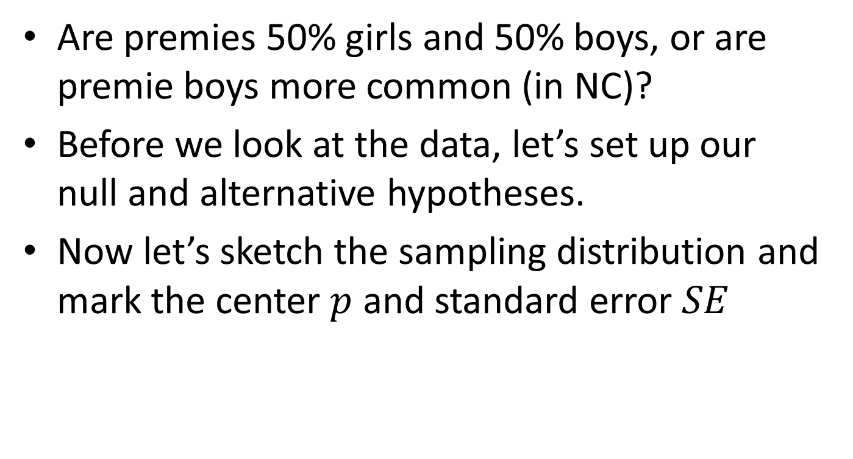
Hypothesis test for 1 proportion
Are premies 50% girls and 50% boys, or are premie boys more common (in NC)?
Before we look at the data, let’s set up our null and alternative hypotheses.
Now let’s sketch the sampling distribution and mark the center $p$ and standard error $SE$

Slide 11
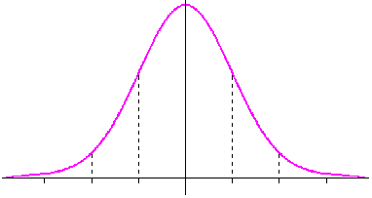
Step 2: The sampling distribution
Nearpod
Find p and SE
$p=0.50$
$SE=\sqrt{\frac{p\left(1−p\right)}{n}}=\sqrt{\frac{.5\left(1−.5\right)}{n}}=.0406$
n = sample size
Go check the data
152 premies
0.42 0.46 0.50 0.54 0.58

Slide 12
Step 2: The sampling distribution
We use a sampling distribution when we want to make claims about a population and we only know about a sample from the population.
If we know about all the newborns in NC, we would not do a hypothesis test.
Nearpod
Find p and SE
$p=0.50$
$SE=\sqrt{\frac{p\left(1−p\right)}{n}}=\sqrt{\frac{.5\left(1−.5\right)}{n}}=.0406$
n = sample size
Go check the data
152 premies
0.42 0.46 0.50 0.54 0.58

Slide 13
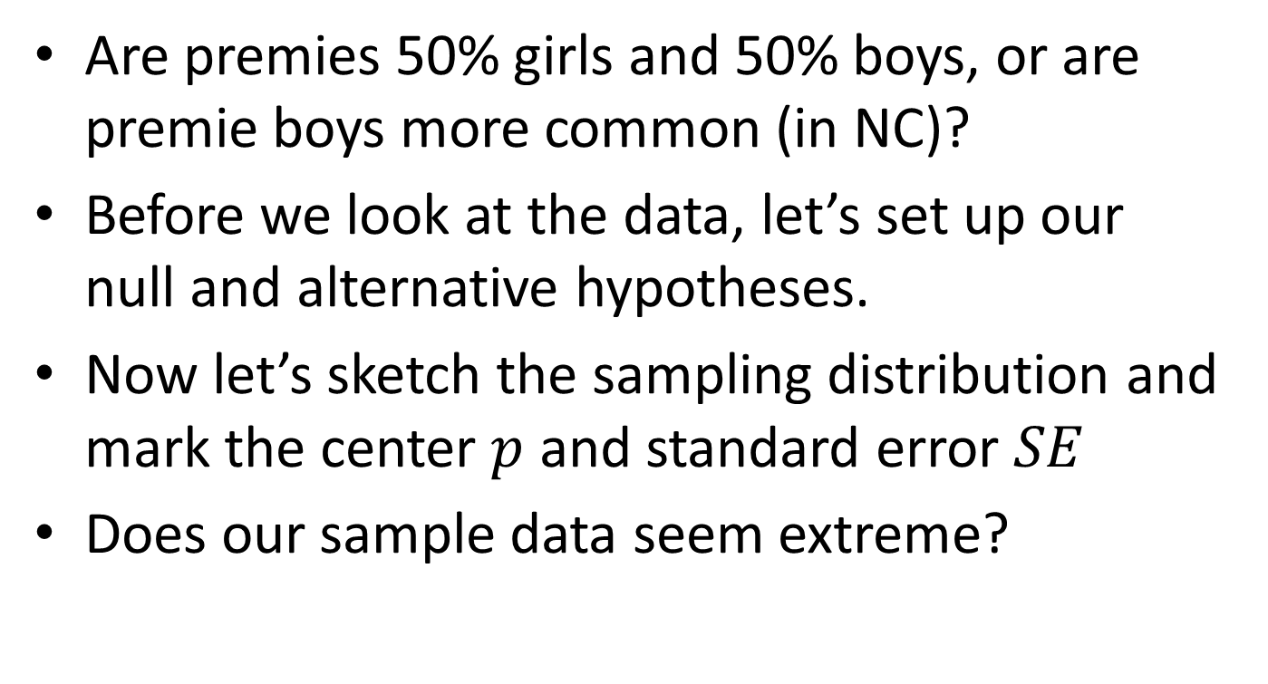
Hypothesis test for 1 proportion
Are premies 50% girls and 50% boys, or are premie boys more common (in NC)?
Before we look at the data, let’s set up our null and alternative hypotheses.
Now let’s sketch the sampling distribution and mark the center $p$ and standard error $SE$
Does our sample data seem extreme?

Slide 14
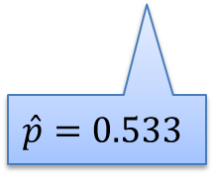
Step 3: The sample data & p-value
$p=0.50$
$SE=\sqrt{\frac{p\left(1−p\right)}{n}}=\sqrt{\frac{.5\left(1−.5\right)}{152}}=.0406$
$\hat{p}=\frac{81}{152}=0.533$
0.42 0.46 0.50 0.54 0.58
$$\hat{p}=0.533$$

Slide 15
Step 3: The sample data & p-value
Nearpod
The p-value for 0.533
$p=0.50$
$SE=\sqrt{\frac{p\left(1−p\right)}{n}}=\sqrt{\frac{.5\left(1−.5\right)}{152}}=.0406$
$\hat{p}=\frac{81}{152}=0.533$
To find the p-value, we need the area to the right of the red line.
0.42 0.46 0.50 0.54 0.58
$$\hat{p}=0.533$$

Slide 16
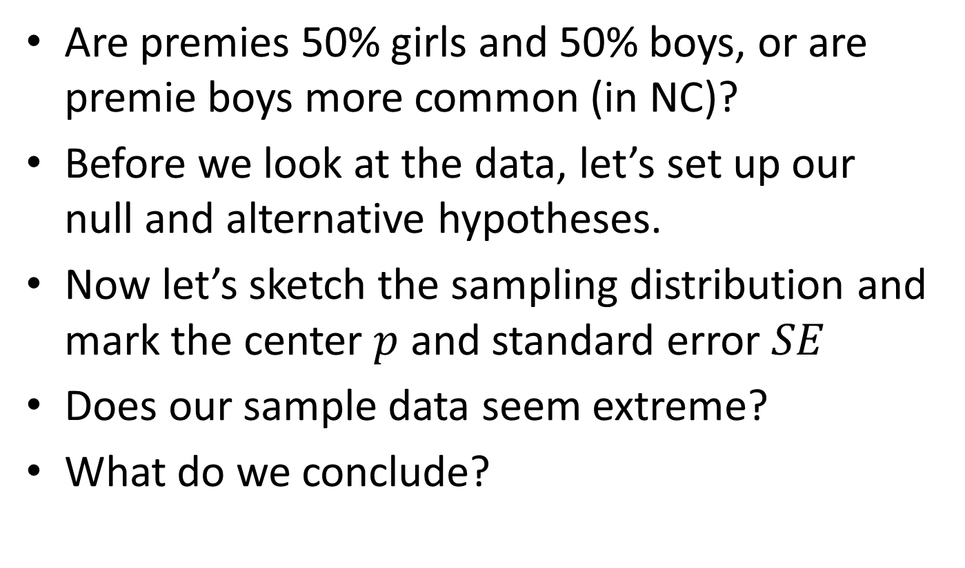
Hypothesis test for 1 proportion
Are premies 50% girls and 50% boys, or are premie boys more common (in NC)?
Before we look at the data, let’s set up our null and alternative hypotheses.
Now let’s sketch the sampling distribution and mark the center $p$ and standard error $SE$
Does our sample data seem extreme?
What do we conclude?

Slide 17
Step 4: Conclusions & interpretations
With a p-value of 0.208, do we reject the null hypothesis, that 50% of premies are boys?
No, we do not reject the null. Our sample data has about 53% of premies in the sample who are boys, but this isn’t far enough from the expected proportion of 50% to provide evidence that boys are more common among premies in NC.
The difference between the sample data (53% male) and the expected 50% may just be from sampling variation.

Slide 18
Step 4: Conclusions & interpretations
With a p-value of 0.208, do we reject the null hypothesis, that 50% of premies are boys?
No, we do not reject the null. Our sample data has about 53% of premies in the sample who are boys, but this isn’t far enough from the expected proportion of 50% to provide evidence that boys are more common among premies in NC.
The difference between the sample data (53% male) and the expected 50% may just be from sampling variation.

Slide 19
An example for you
Is smoking less common among pregnant women than the general population of women? Nationally, about 13% of women smoke.
Step 1: Set up hypotheses
Step 2: Set up sampling distribution (Sketching the curve, finding p and n and SE)
Step 3: Find the p-value of the sample proportion $\hat{p}$
Step 4: Draw conclusions

Slide 20
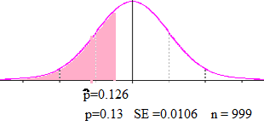
An example for you
Is smoking less common among pregnant women than the general population of women? Nationally, about 13% of women smoke.
Step 1: Set up hypotheses
Step 2: Set up sampling distribution (Sketching the curve, finding p and n and SE)
Step 3: Find the p-value of the sample proportion $\hat{p}$
Step 4: Draw conclusions
$$H_{0}:p=0.13$$
$$H_{1}:p<0.13$$
$$p−value=0.358$$
Do not reject the null hypothesis, we do not have enough evidence to say the smoking rate is lower for pregnant women in NC.

Slide 21
Problem 3
Approximately 8%* of pregnant women in the US reported smoking in 2014. Is the rate of smoking higher than this in NC for women 35 and under?
Clearly label your hypothesis testing steps and include an appropriate graph.

Slide 22
Problem 4 – Confidence Intervals
a) Looking just at women who smoked, create a 95% confidence interval for the proportion of babies who were premies in NC.
b) Looking just at women who did not smoke, create a 95% confidence interval for the proportion of babies who were premies in NC.

